Slide 1



Slide 2



The Urban Noise Crisis in Moroccan Cities
85–90+ dB

Slide 3


ECHOLYTIX: AI-Powered Urban Noise Monitoring in Morocco
ECHOLYTIX combats noise pollution in Morocco's urban centers. Our AI-driven solution addresses noise pollution's health impacts. Discover how smart monitoring technology transforms urban planning. We aim to improve the quality of life across Moroccan cities.

Slide 4
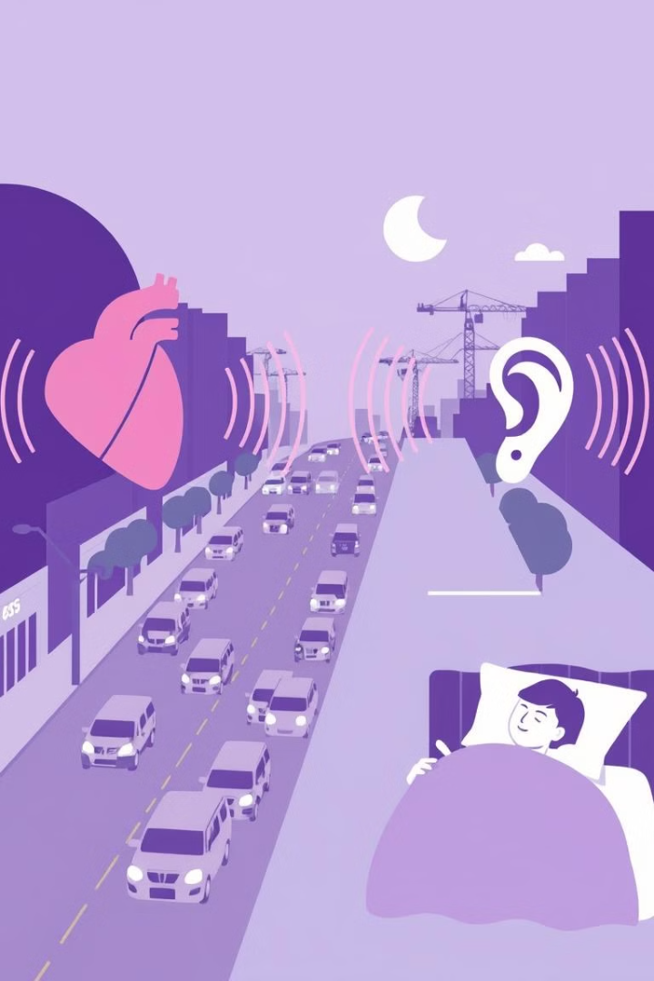
Health Consequences of Noise Pollution
Elevated stress-related disorders (cortisol levels up 30%).
Sleep disturbances affecting 45% of urban residents.
Cognitive impairment, especially in children attending noisy schools.
Prolonged acoustic exposure poses severe and wide-ranging health consequences.

Slide 5

Understanding Urban Noise Pollution
Urban noise is a complex challenge with overlapping sound sources. Vehicular traffic accounts for 65% of ambient urban noise. Industrial activities and construction contribute to noise events exceeding 100 decibels. Entertainment venues disrupt sleep patterns late into the night.

Slide 6
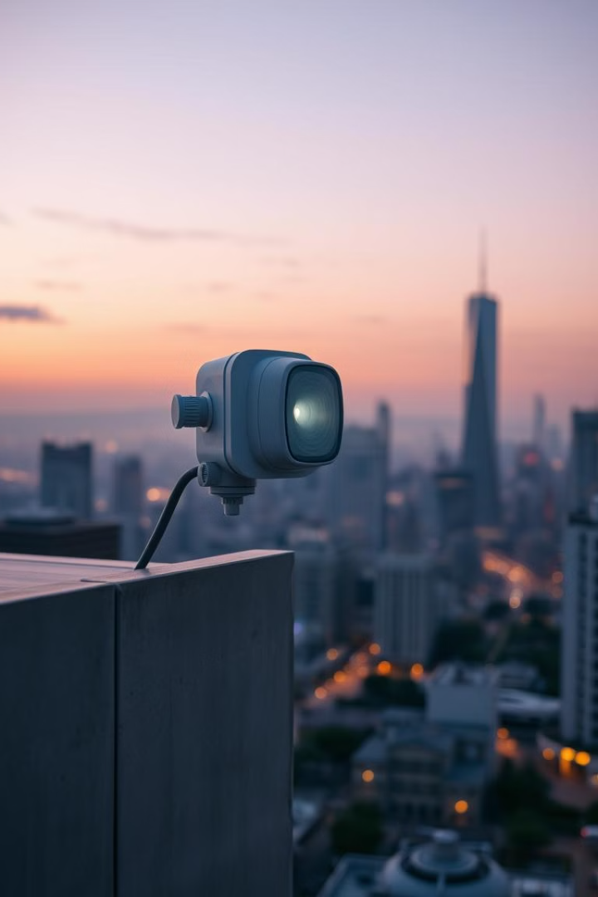
Technology Solution: AI-Driven Noise Monitoring
ECHOLYTIX offers real-time sound level tracking across multiple city zones. Advanced acoustic sensors continuously measure and analyze sound patterns. Encrypted data transmits to secure cloud processing systems. Our AI algorithms identify noise sources using spectral analysis.

Slide 7
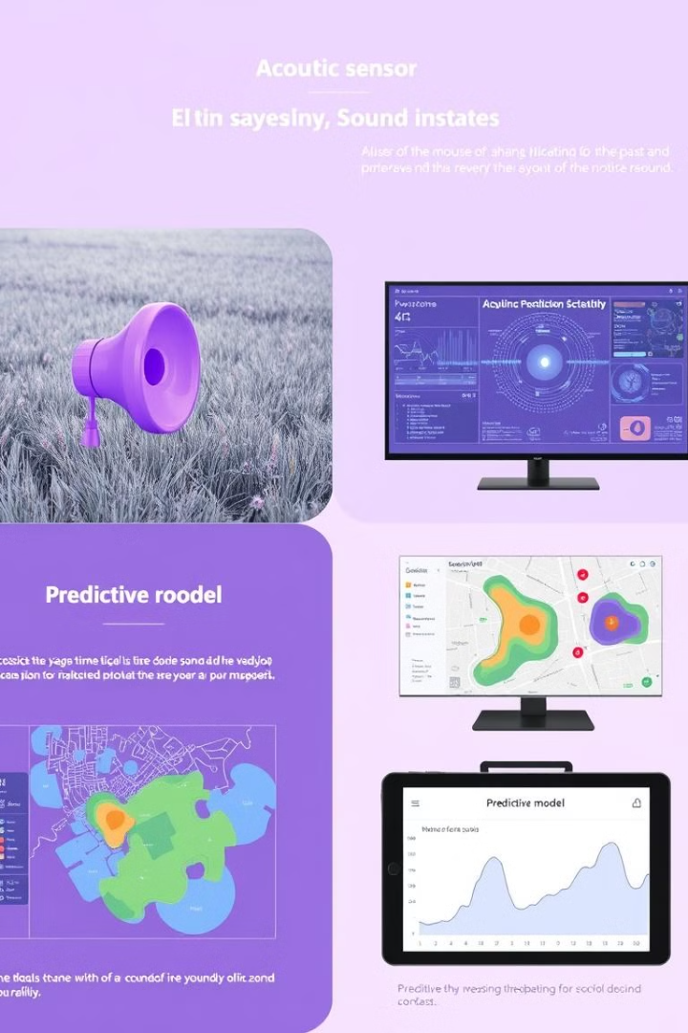
Sound Capture, Analysis, Visualization & Prediction
Advanced acoustic sensors capture continuous audio data. Encrypted sound data transmits to secure cloud systems. Machine learning algorithms identify noise sources. Dynamic noise maps show predictive sound conditions.

Slide 8

Health and Quality of Life Implications
Cognitive performance: Noise above 65 decibels increases cognitive decline risk by 40%. Cardiovascular health: Noise pollution increases hypertension risk by 20-30%. Sleep disruption: Nighttime noise reduces restorative sleep up to 35%.

Slide 9

Data-Driven Urban Planning
ECHOLYTIX provides comprehensive noise mapping for proactive urban planning. We pinpoint noise pollution hotspots. This allows resources to be directed effectively to high-impact areas. Our solution enables the integration of sound environment considerations.

Slide 10
Business Model and Target Clients
Subscription Model
Key Partners
Targeted Clients
Clients pay a recurring fee for access to ECHOLYTIX's noise monitoring platform and data.
Local city authorities.
Urban planners and policymakers.
Environmental agencies.
Public health organizations.
Real estate developers.
Educational institutions.

Slide 11
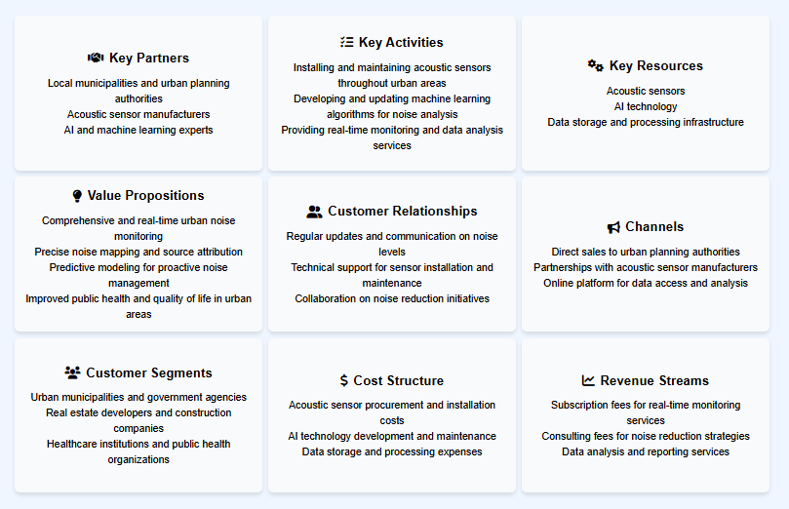

Slide 12

How we will grow ?
1
Cost Savings
2
Investment
Effective noise mitigation can reduce healthcare costs and productivity losses.
Smart planning provides long-term value and economic returns for the community.
3
Funding
ECHOLYTIX qualifies for city incentives supporting sustainability initiatives.

Slide 13

Financial Study
Review of the financial metrics for ECHOLYTIX over the next 5 years.
$2.5M
40%
ARR
Profit
Projected annual recurring revenue by Year 3.
Target profit margins through cost optimization.
300%
Growth
Expected growth by year five from expansion.

Slide 14




Impact and SDGs
ECHOLYTIX aligns with UN Sustainable Development Goals. We are reducing noise, and improving urban environments.
Health
Cities
Environment
Reduced noise pollution boosts public health.
Data-driven planning for sustainable cities.
Monitoring helps protect urban ecosystems.

Slide 15



Our Team
The Calm Keepers
Mounsef
Litniti
Badr
Tadlaoui
Othman
Sadiki

Slide 16


Thank You

